Slide 1
Phosphates and Carbonyl Chemistry
Quick Recap

Slide 2
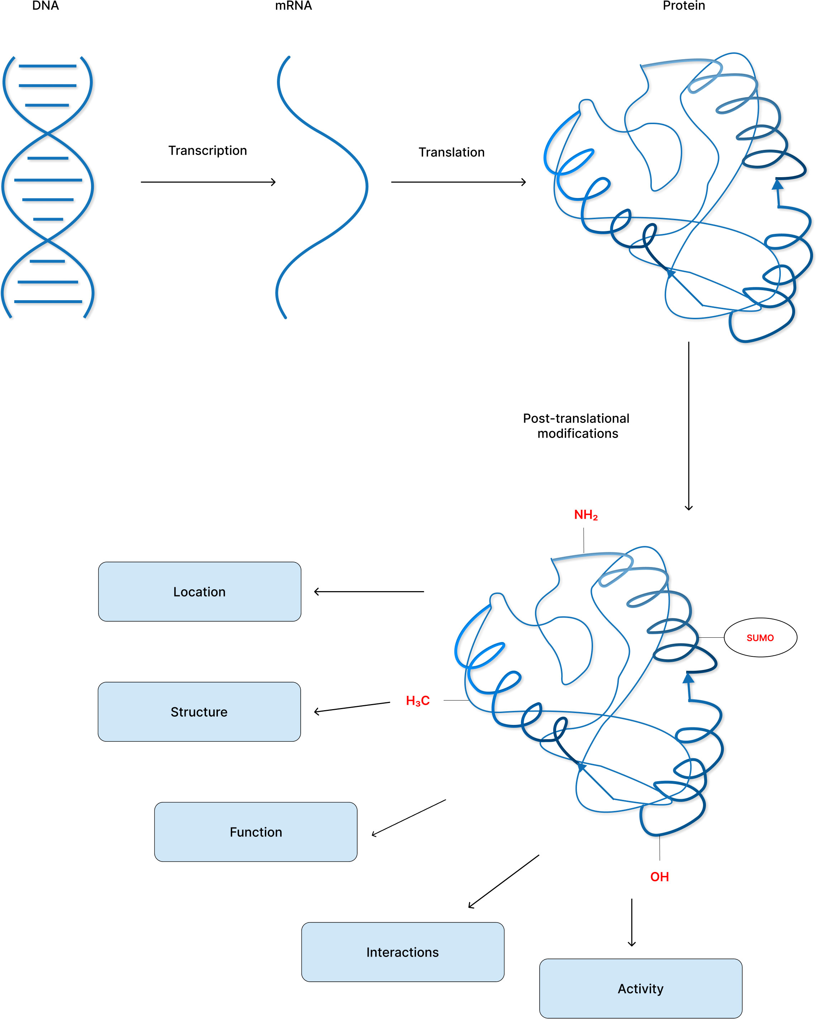
Why do we care about Phosphates?
Adapted from: Dutta & Jain, 2023

Slide 3
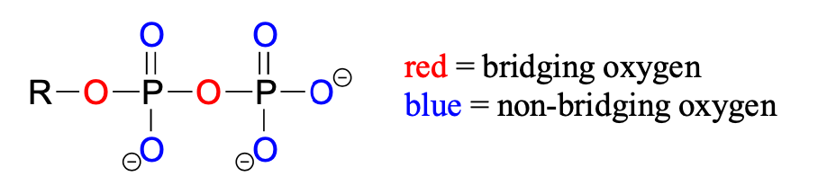
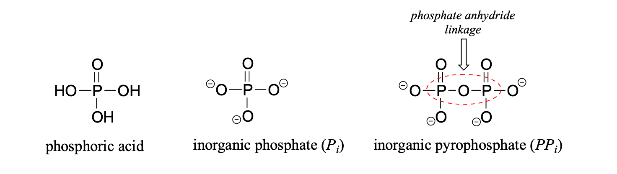
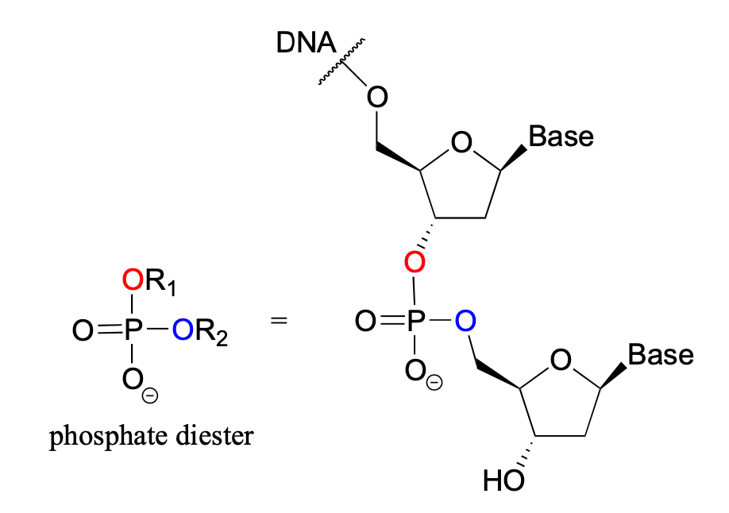
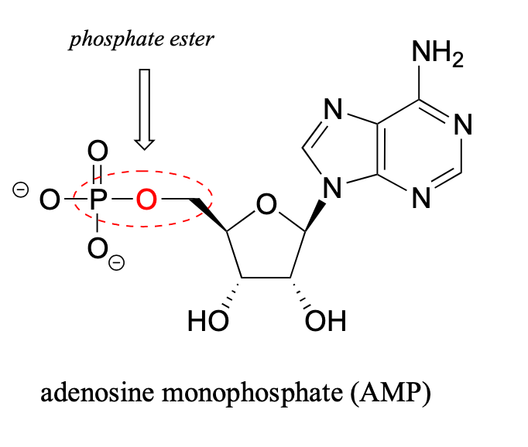
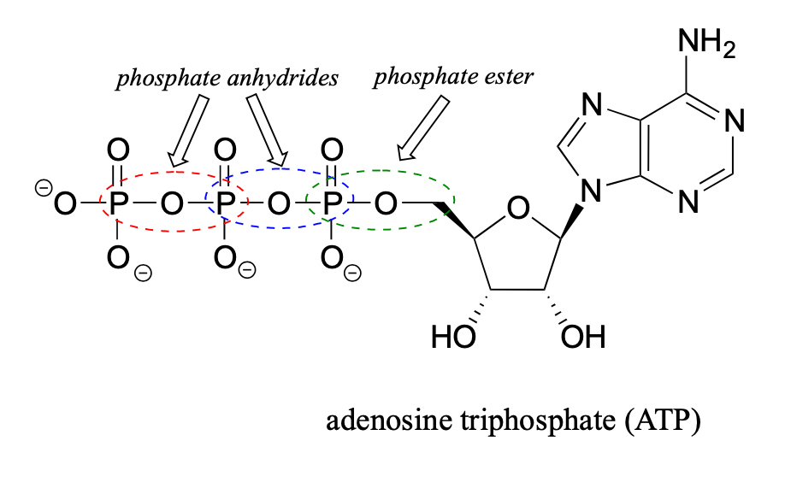
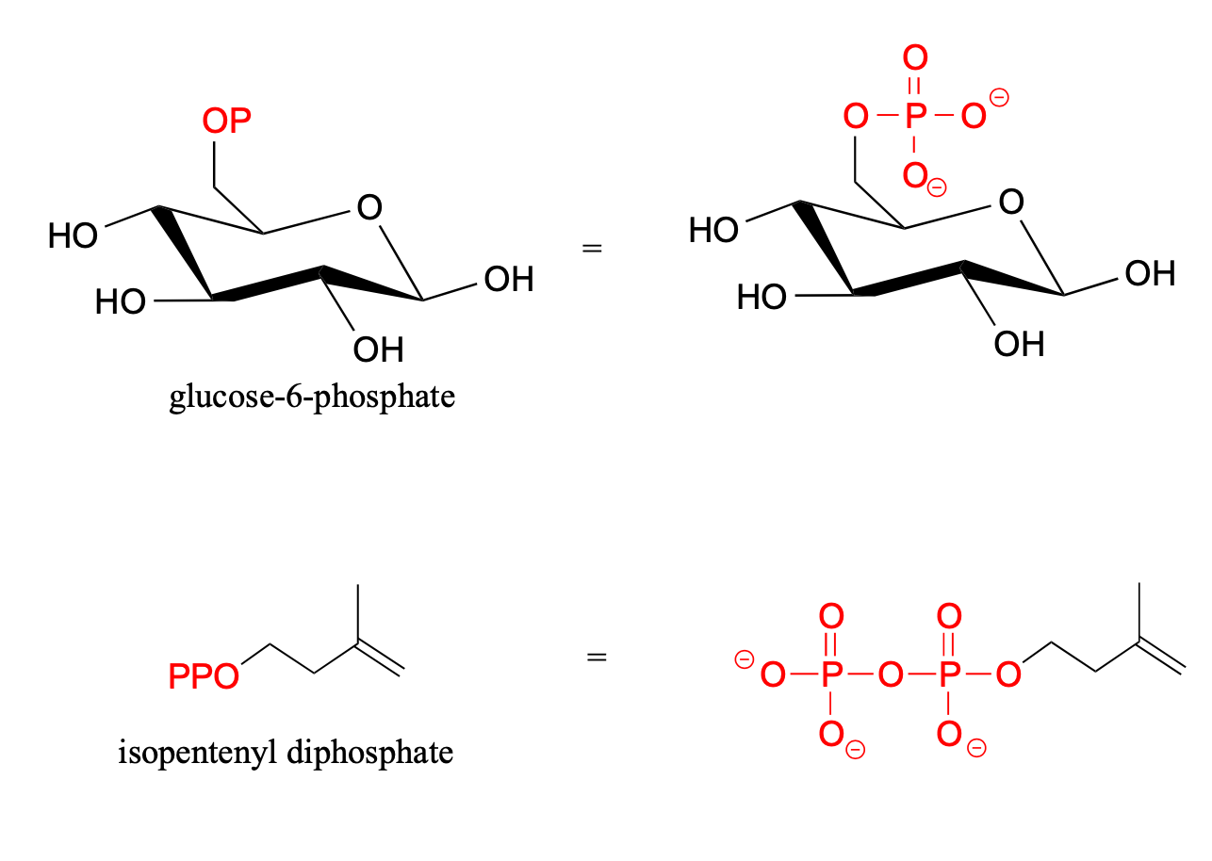
Lets review some nomenclature

Slide 4
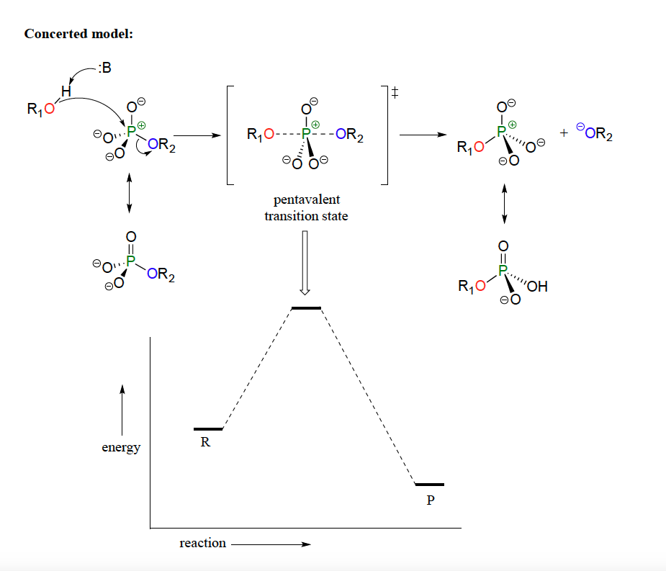
Mechanism of Phosphotransfer
-Phosphate transfer reaction can be thought of much like an SN2 reaction
-Nucleophile attacks the phosphorus atom from the opposite side
- geometry around the phosphorus atom shifts from tetrahedral to trigonal bipyramidal at the transition state with five bonds.
-Phosphorus undergoes a temporary change in bonding, shifting back to its initial tetrahedral state after the nucleophile and leaving group alteration.

Slide 5
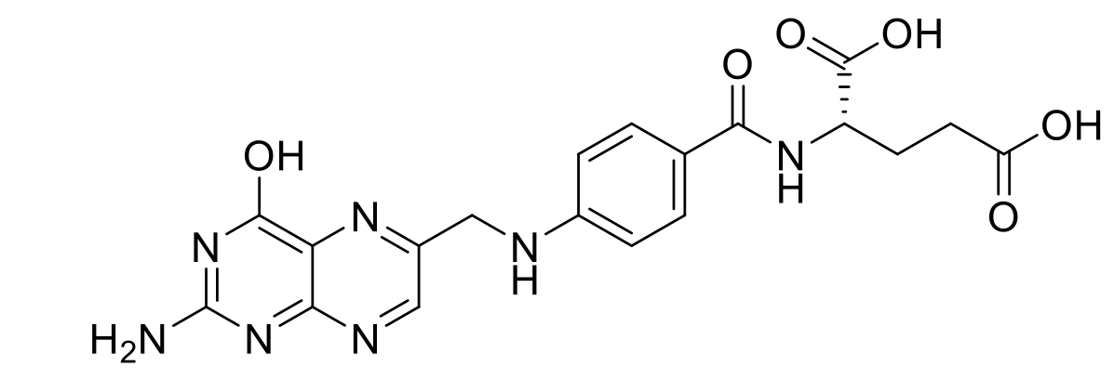
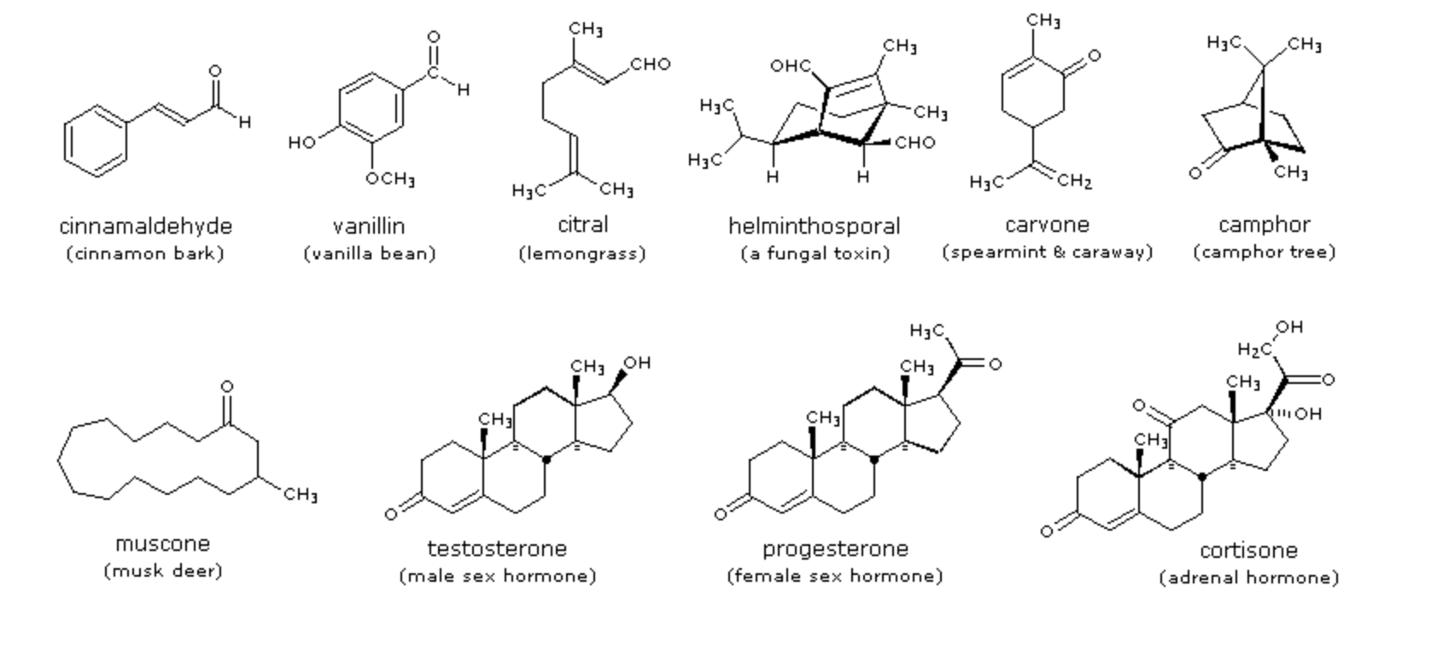
Carbonyl Chemistry – They are everywhere!
Peptide backbone
folic acid
acetylsalicylic acid
(Aspirin)
acetaminophen
(Paracetamol, Dafalgan)
strychnine

Slide 6
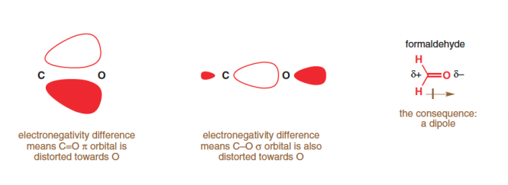
Basics of carbonyl reactivity
Electronic Effects
Steric Effects
Steric Hindrance
Partial charge on carbon 𝝳⁺
Reactivity
Reactivity

Slide 7
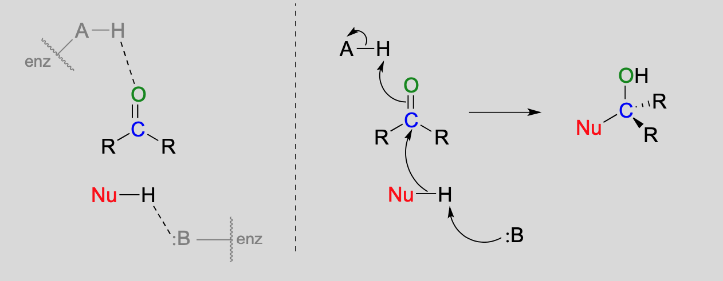
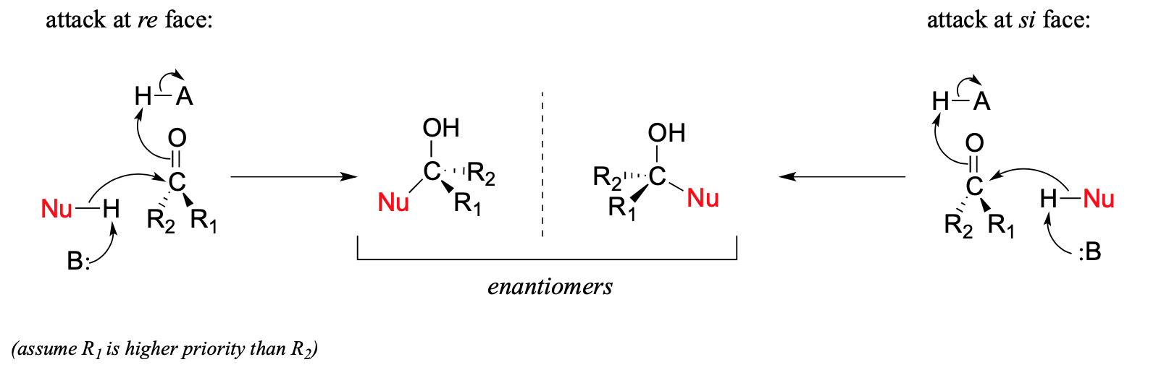
Carbonyls as electrophiles
3

Slide 8
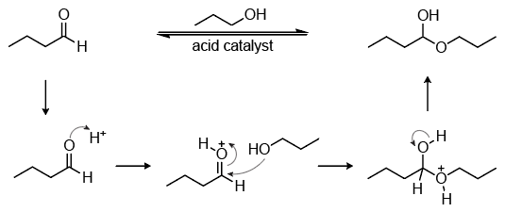
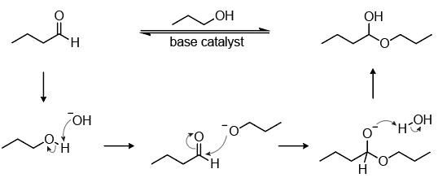
Reaction with acid/bases

Slide 9
Addition vs. Substitution
Is R₁ or R₂ a good leaving group?
Feature | Addition | Substitution
Substrate | Aldehyde, Ketone | Ester, Acid Chloride, Thioester
Leaving Group | None | Present (–OR, –Cl, –SR)
Mechanism Outcome | Adds nucleophile | Swaps one group for another
Biological Relevance | Sugar chemistry, metabolism | Protein, lipid, nucleotide biosynthesis

Slide 10
Phosphates and Carbonyl Chemistry
Solutions Exercise 8

Slide 11
8.3. Reactivites of carbonyls
Remember:
Steric Hindrance
Partial charge on carbon 𝝳⁺
Reactivity
Minor resonance contributor, but explains reactivity!

Slide 12
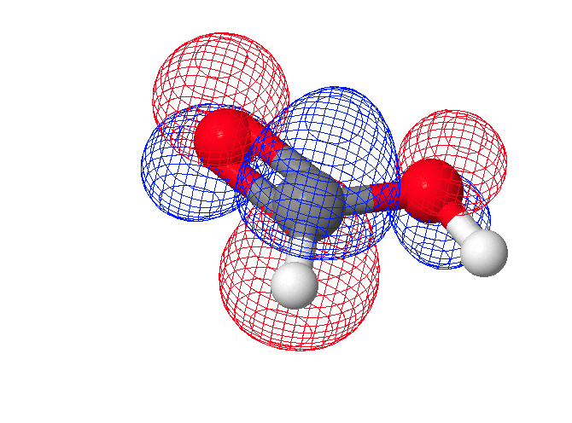
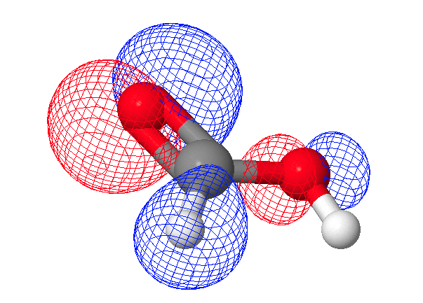
8.3. Reactivities of carbonyls
Let’s have a brief look at the HOMO and LUMO orbitals of formic acid
HOMO (π MO)
LUMO (π* MO)
If we are going to add electrons to this system, the electrons will go into the LUMO, which has its highest density at the carbonyl carbon
Carbonyl Carbon is the Electrophile
From: https://www.swisseduc.ch/chemie/molekularium/mo/mo.htm

Slide 13
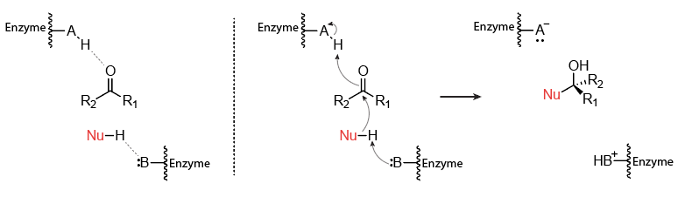
8.4. c) Enzymatic catalysis
Important: Enzymes are usually stereospecific; they are orienting the substrate in their binding pocket in such a way that only one isomer is produced.

Slide 14
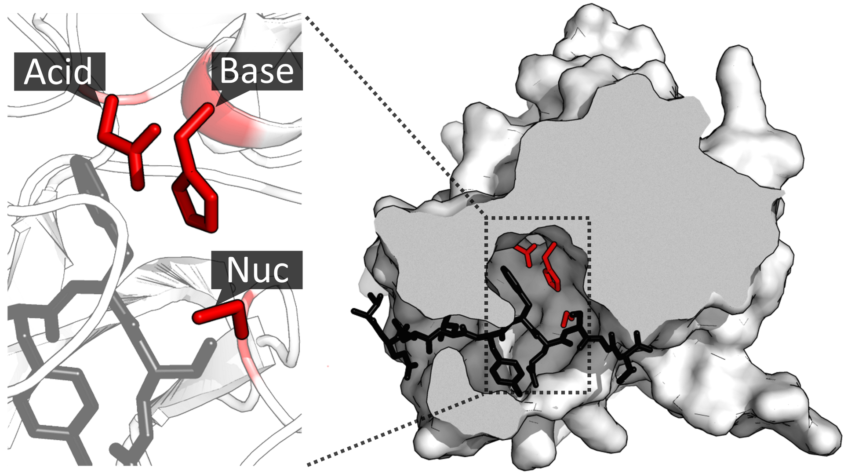
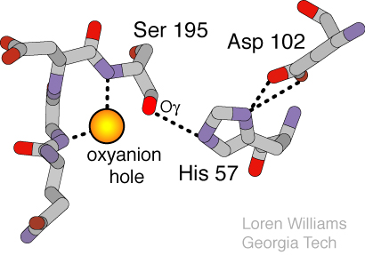
8.4. c) Proteases are a great example of activated Nucleophiles (Not an addition but substitution!)
Adapted from Wikipedia https://en.wikipedia.org/wiki/Catalytic_triad, and https://williams.chemistry.gatech.edu/structure/protein/serine_protease/triad_1.html PDB: 1LVM

Slide 15
8.5. Organometallic reactions
Inserting Lithium or Magnesium into a Carbon-Metal bond will lead to ”umpolung” which makes the carbon next to the Metal electronegative!

Slide 16
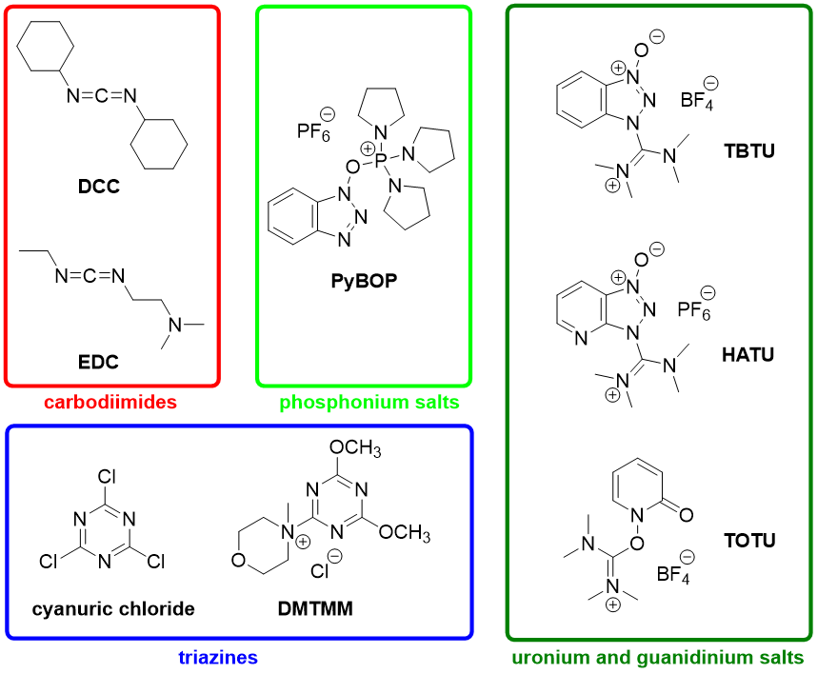
8.7. Peptide Chemistry
Remember O- is a very bad leaving group, so substitution will be very hard…
Solution: create activated esters! Some key reagents that are frequently used:

Slide 17
8.7. Peptide Chemistry

Slide 18
8.8. Protein Crosslinking

Slide 19
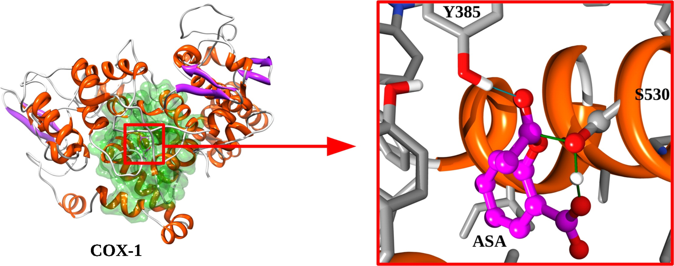
8.8. Aspirin

Slide 20
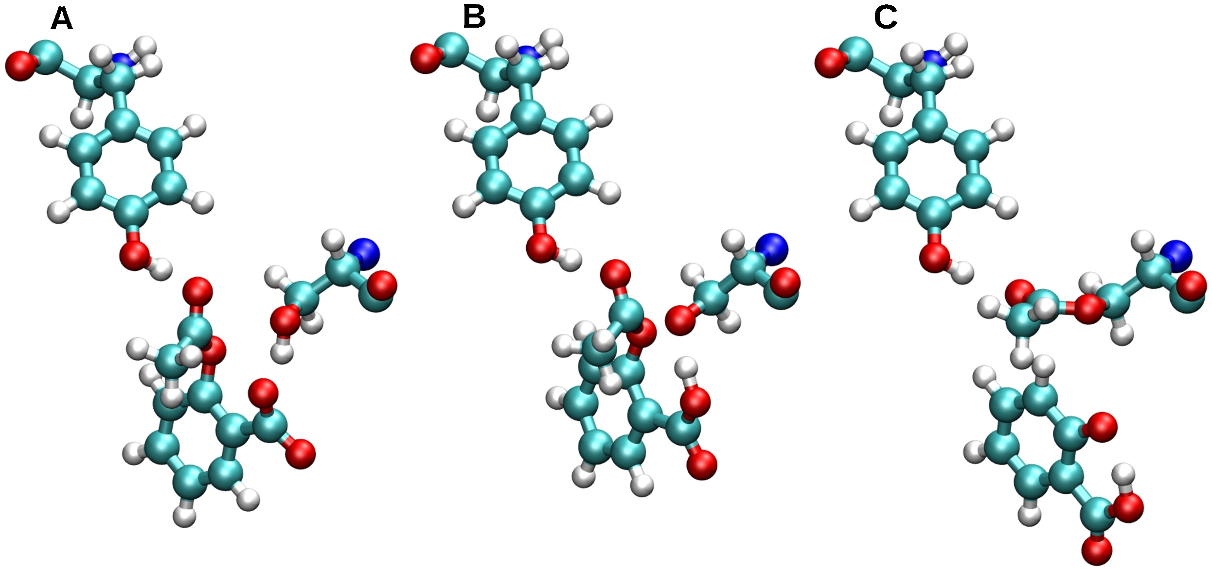
8.8. Aspirin

Slide 21
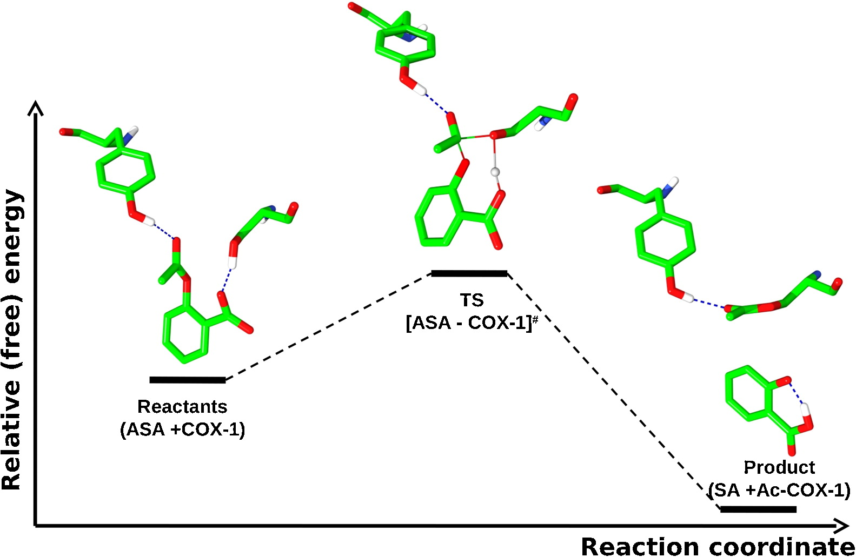
8.8. Aspirin

